Slide 1
Developing A Statewide
Nurse Leader Mentorship Program
Presented by:
Tracy Vitale, DNP, RNC-OB, C-EFM, NE-BC
Organization of Nurse Leaders of NJ
Chair – Mentorship Committee
April 6, 2018

Slide 2
Additional Credits:
Mary Jo Loughlin, MAS, RN, NE-BC
Mary Rich, MSN, MAS, RN, NE-BC, CCRN

Slide 3
Objectives
Identify the process for development of a nurse leader mentorship curriculum and implementation of a statewide program.
Apply the tools and methods to initiate a mentorship program in other healthcare organizations and state AACN chapters.
Correlate the value of the mentorship program with AACN, AONE, IOM, and Magnet standards supporting nurse leader growth and development.

Slide 4
Organization of Nurse Leaders of NJ
Established 1971 as the Organization of Nurse Executives of New Jersey (ONE NJ)
Voice of Nursing Leadership in NJ
Membership: nearly 600 current & aspiring Nurse Leaders
Represents 90% of NJ hospitals
Headquarters: New Jersey Hospital Association (NJHA) in Princeton, NJ
Notes:
Vision: Transform the future of healthcare in NJ through innovative nursing leadership.
Membership includes:
Aspiring Nurse Leaders
Educators
Academia
Nurse Managers
Clinical Nurse Leaders
Administrative Directors of Nursing and Patient Care
Vice Presidents of Nursing
Chief Nursing Officers
Nurse Researchers
Healthcare Business Representatives
Retired Nursing Leaders
Nursing Leaders across the healthcare continuum

Slide 5
Mentoring
  Classic nursing definition of mentoring by Bowen (1985):
    senior person (the mentor) provides information, advice, and emotional support to the junior person (the mentee).
    extended period of time and marked by substantial emotional commitment by both partners.
    If the opportunity presents itself, the mentor also uses both formal and informal forms of influence to further the career of the mentee.
Notes:
Donald Bowen

Slide 6
Mentoring
  Another nursing leader, Linda Yoder, accepted Bowen’s definition of Mentorship, expanded the concept, and defined six critical attributes to the mentoring process including a:
      Teaching and learning process
      Reciprocal role
      Career development relationship
      Knowledge or competence differential between participants
      Duration of several years
      Resonating phenomenon
Yoder (1990)
Notes:
The ONL NJ Mentorship Committee considered all 6 attributes in the program development.
Linda Yoder, MSN, MBA, Major, United States Army Nurses Corp, Philadelphia, PA

Slide 7
Mentoring
  Findings: Individuals experiencing extensive mentoring relationships reported receiving:
    Promotions
    Higher incomes
    Greater satisfaction with pay and benefits than individuals experiencing less extensive mentoring relationships
(Dreher & Ash, 1990)

Slide 8
Mentoring
  Chung & Kowalski, 2012
    Study results demonstrated 40% of the sample had a current work mentor.
    Variables showed significant relationships to:
      Job satisfaction (p < 0.01)
      Job stress (p < 0.01)
      Psychological empowerment (p < 0.01)

Slide 9
Mentoring
  ONL NJ embarked on a multi-year journey to create a structured mentorship program for the development of current and aspiring nurse leaders in alignment with the:
  American Organization of Nurse Executives
  Institute of Medicine
  American Nurses Credentialing Center
  American Association of Critical-Care Nurses

Slide 10


Mentoring
Institute of Medicine
Recommendation 7: Prepare and enable nurses to lead change to advance health.
Nursing associations should provide leadership development, mentoring programs, and opportunities to lead for all members.
.
Notes:
Recommendation 7: Prepare and enable nurses to lead change to advance health.
Nurses, nursing education programs, and nursing associations should prepare the nursing workforce to assume leadership positions across all levels, while public, private, and governmental health care decision makers should ensure that leadership positions are available to and filled by nurses.
• Nurses should take responsibility for their personal and professional growth by continuing their education and seeking opportunities to
develop and exercise their leadership skills.
• Nursing associations should provide leadership development, mentoring programs, and opportunities to lead for all their members.
• Nursing education programs should integrate leadership theory and business practices across the curriculum, including clinical practice.
• Public, private, and governmental health care decision makers at every level should include representation from nursing on boards, on
executive management teams, and in other key leadership positions.

Slide 11

Mentoring
American Organization of Nurse Executives
Mission: To shape health care through innovative and expert nursing leadership
Launched AONE Leader2Leader Mentorship Program
Matches mentors and mentees based on AONE core competencies
Notes:
American Organization of Nurse Executives (AONE) has provided leadership, professional development, advocacy, and research to advance nursing practice and patient care, promote nursing leadership excellence and shaping public policy for health care nationwide.
The AONE Leader2Leader Mentorship Program connects AONE members from across the country for nursing leadership skill development through mentoring and personal relationships. Mentorship provides experienced nurse leaders an opportunity to develop the next generation and provides mentees with guidance and resources for leadership as they are growing in their career.
Leader2Leader Mentorship Program Highlights:
•Matching of mentors and mentees based on AONE core competencies for nurse managers and executives
•Pre, mid, and post-mentorship assessments
•Discussion forums and advice sections for mentors and mentees
•Set milestones for optimal mentoring experience

Slide 12
Mentoring
AONE 2016-2018 Priorities
Priority 1: Develop core competencies of nurse leaders across the care continuum to support current and emerging roles.
Priority 4: Communicate the value of nursing in health care across the continuum to all stakeholders.
Notes:
Priority 2: Support the design and implementation of care delivery and population health management models across the continuum.
Priority 3: Support the provision of safe, quality care in delivery systems grounded in healthful practice environments.
Priority 5: Optimize the operational effectiveness of AONE.

Slide 13
Mentoring
AONE Priority 1 Strategies
1A: Utilize the AONE competencies to develop resources that ensure nurse leaders across the care continuum have the core competencies needed to lead in the changing health care environment.
http://www.aone.org/docs/About/aone-strategic-plan.pdf

Slide 14
Mentoring
AONE Priority 1 Strategies
1B: Create innovative leadership and governance development programs that provide nurse leaders with the skills and knowledge needed to effectively serve, across the care continuum and throughout the global community.
http://www.aone.org/docs/About/aone-strategic-plan.pdf
Notes:
The global community is defined as local, state, regional, national, and international.

Slide 15
Mentoring
AONE Priority 1 Strategies
1C: Accelerate adoption of innovative best practices through educational resources, tools and leadership development for nurse leaders at all stages of their careers, across the care continuum.
http://www.aone.org/docs/About/aone-strategic-plan.pdf

Slide 16



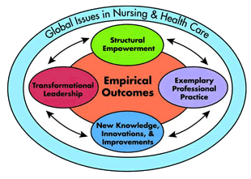
Mentoring
American Nurses Credentialing Center (ANCC)
Pathways to Excellence
Magnet Standard: Transformational Leadership
Focus on mentoring & succession planning
Notes:
Transformational Leadership (TL) 6: The CNO advocates for organizational support of ongoing leadership development for all nurses, with a focus on mentoring and succession planning.
Provides one example, with supporting evidence, of each of the following activities:
Mentoring or succession planning activities for clinical nurses
Mentoring or succession planning activities for nurse managers
Mentoring or succession planning activities for nurse leaders (exclusive of nurse managers)
Mentoring or succession planning activities for the chief nursing officer

Slide 17
Mentoring
  Nurse leaders from several healthcare systems throughout the state established and developed the initial structure for a statewide mentorship program and included:
  Chief Nurse Executives
  Assistant Vice Presidents
  Nurse Directors

Slide 18
Mentoring
  The first cohort was launched in 2011 with a call for mentors and mentees from the ONL NJ membership.
  Potential mentors and mentees were required to submit a resume and complete a Myers-Briggs Personality Assessment.
  Mentors listed management strengths.
  Mentees listed areas for development.

Slide 19

Mentoring
  With the data submitted from the mentors and mentees, the Mentorship Committee began the matching process.
  Some committee members recommended matching like personalities, others proposed matching opposite personalities.
  Since there was a lack of consensus, the Committee did not use the Myers-Briggs Personality Assessment for matching.

Slide 20
Mentoring
  Development of Mentorship Liaison Role
  One Mentorship Committee member was assigned to serve as a liaison for each mentor-mentee pair.
  The liaisons periodically check-in with their assigned pair to inquire how the mentee/mentor relationships were developing.
  The liaisons were available to the dyad for issues and concerns.

Slide 21
Mentoring
  We matched by request of mentee to the role he/she desired to be mentored by; examples are:
    Nursing specialty and geographic location were also considered.
Mentee | Mentor
Director | CNO
Nurse Manager | Director
Nurse Educator | Seasoned Educator
New Researcher | Seasoned Researcher
New Bed Manager | Seasoned Bed Manager

Slide 22
Mentoring
  Guidelines were developed for the frequency of mentor-mentee meetings.
  Cohort I launched with 11 pairs.
  Based upon extremely positive feedback from the liaisons, the Committee launched Cohort II.
  The Myers-Briggs Tool was not used.
  Pairs were matched based upon the mentee request, type of mentor position desired, and specialty.

Slide 23
Mentoring
  The second cohort did not go as well.
  Some pairs never connected.
  One match was not good and the mentee did not know who to report to.
  The remaining pairs reported a positive experience.

Slide 24
Mentoring
  The Mentorship Committee recognized the need to reevaluate the program.
  With the assistance of the ONL NJ Research Committee and the doctoral prepared nurses in the organization, the Mentorship Committee recommended a qualitative research study.

Slide 25
Qualitative Research Study
Interviews via focus groups at the New Jersey Hospital Association:
  5 mentees
  4 mentors
  Data collection conducted via audio-taped records and transcribed verbatim by professional transcription services.
  Only the research facilitators and the ONL NJ Executive Director were permitted to hear tapes and read the transcripts.
Notes:
Discuss and reflect on the experience of the ONL NJ Mentoring Program
Mentors/Mentees from Cohorts I & II invited to participate
IRB Approval through St. Joseph’s Regional Medical Center, Paterson, NJ
Informed consent for voluntary participation

Slide 26
Focus Group Questions
  What was your role in the mentor/mentee relationship?
  Tell me about your experience overall.
  What did you learn from the mentor/mentee experience?
  What are your thoughts about continuing the program for future mentor/mentee pairs?
  What would you have liked to experience differently?

Slide 27
Quotes
  “I have enjoyed the mentorship program. I have learned a lot and it is nice having someone with so much experience to mentor me.”
  “Mentoring has been a hallmark of my success. Therefore, I believe in mentoring and think all employees, particularly nurses should receive mentoring.”
  As the mentor, I was pleasantly surprised to gain as much as I gave during the mentoring process.”

Slide 28

Research Study Results
Themes
Making a Connection
Giving and Getting
Emotional Roller Coaster
Logistics
It Can’t be Forced
Sub-Themes
Safety
Boundaries
Strangers
Notes:
Although sample size was very small, the best matches occurred when the mentor and mentee had a relationship. The potential mentor and mentee may need to meet to determine if the relationship will be a good match.
Mentees had very specific issues with regard to making changes in the workplace and resolving specific problems.
Mentors did not feel they had control over some of the issues or changes the mentee wanted to address.
The logistics of distance can derail the mentorship experience.

Slide 29
Recommendations
  Design educational session
  Reevaluate/restructure matching process
  Improve support structure
  Consider secondary mentors
  Create toolkit
Notes:
Develop contract and self-reflection tools.

Slide 30

Development of the Toolkit
  A sub committee was formed from the Mentorship Committee.
  Members had expertise in practice or academia.

Slide 31

The Mentorship Committee
Vision:
  To have written materials in the form of a toolkit to help guide the mentoring process and support the developing relationship from beginning to end.

Slide 32
Toolkit Foundation
  The Mentorship Committee established a mission, purpose, and definitions for terms such as mentor, mentee, or facilitator.
  These original materials became the foundation for the Toolkit.
  We began by revising some of the definitions as many were unclear.

Slide 33
Literature Search
  We performed a literature search and narrowed our results to readily available resources that would assist in meeting the overall objectives of our program.
  Three closely aligned:
    The University of California, San Francisco,
    Mentoring Toolkit
    The Ontario Nurses Association,
    Mentoring Toolkit
      The Academy of Medical Surgical Nurses,
      Mentoring Program

Slide 34
Essential Topics
  Self assessment
  Program implementation
  Program development
  Program evaluation
  Relationship building techniques
  Problem solving strategies

Slide 35

Toolkit Phases
  Orientation phase
  Working phase
  Separation Phase

Slide 36
Orientation Phase
  Getting to know each other.
  Sharing information about yourself.
  Building rapport.
  Defining clear roles and expectations.
  Establishing the purpose and expected benefits of the mentoring journey.

Slide 37
Working Phase
  Establishing how the mentoring pair will work together.
  The mentoring pair identifies more specific needs and goals, and starts working towards them.
  Giving and receiving feedback.
  Reviewing and revising goals.
  Developing desired outcomes.

Slide 38

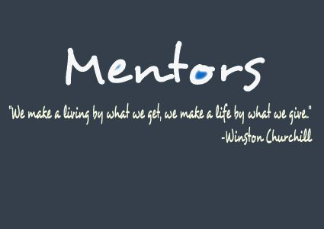
Separation Phase
  Confirming that the mentoring relationship has achieved its goals.
  Some pairings at this point may choose to continue the relationship as colleagues and friends.

Slide 39
Support for the Phases
Material support related to these phases included:
  Definition of terms
  Descriptions of the phases of the mentoring relationship
  Checklists to help participants formulate goals
  Prepare for the meeting materials and evaluation of progress

Slide 40

Supplemental Resources
  The Committee recognized that not all users of the toolkit would have the same level of experience in mentoring.
  Supplemental resources were added to assist less experienced mentors and mentees.

Slide 41
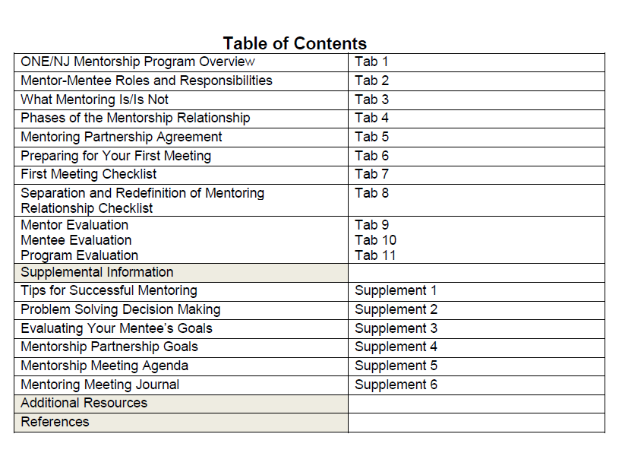
Toolkit Table of Contents

Slide 42
Education Workshop Program
  Collaboration with the ONL NJ Education Committee.
  Development of a 2-day educational program:
    “Mentor-Mentee Relationships for Successful Professional Growth for Nurse Leaders and Aspiring Nurse Leaders”
Notes:
Continuing on with the process just outlined regarding the toolkit, the team focused on developing an education program.
The Mentorship Committee collaborated with the Education Committee to develop a program that would provide nursing leaders, mentors and mentees an opportunity to network and be oriented to this new resource.
A 2 Day Educational program entitled “Mentor-Mentee Relationships for Successful Professional Growth for Nurse Leaders and Aspiring Nurse Leaders” was created with a focus on providing the structure for a mentorship program and mentoring relationships.
The 2 day educational program began first with a 3 hour evening dinner session followed by a full day educational interactive program.
One of the very first steps in this process was to identify our target audience. We sought ONE members interested in becoming a mentor and/or mentee. We have a wealth of knowledge within our over 500 member organization and easily identified nurse leaders that would fit the role of mentor.
We also developed an application process which included a very brief survey monkey questionnaire to help with identifying strengths, weaknesses, experiences and work environments.

Slide 43
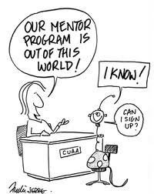
Workshop Structure
  Guest Speaker/Facilitator:
  Karren Kowalski PhD, RN, NEA-BC, FAAN
  Evening Session
  Full Day Session
Notes:
So we geared the first part of our 2 day program specifically towards previous ONENJ mentors, our BOD, committee chairs. and members with a focus on discussing mentoring and coaching competencies. Whereas the second day was geared towards nurse managers, staff nurses, CNOs, new ONENJ mentors and mentees.
Our Key Note Speaker for both days, Dr. Karren Kowalski, is the President and CEO of the Colorado Center for Nursing Excellence. She has developed innovative and creative approaches to problem solving, has authored numerous articles, co-edited five advanced textbooks, and has had a decorated career as a nurse for many years.

Slide 44


Evening Session
  Principles of Trust, Self Reflection, Self Awareness and Authenticity.
  “What will be your legacy?”
Notes:
Dr. Kowalski spoke to this evening group during a casual session with a focus on connection exercises to foster meaningful dialogue.
The dinner and conversation session defined the goals and objectives for the ONENJ Mentorship program and addressed mentoring competencies including establishing trust, honoring confidentiality and creating an agenda for meeting sessions. The use of questions, active listening, demonstrating positive regard for the mentee, engaging in direct communication, stimulating self reflection and self awareness, supporting the mentee in the development of action plans and how to monitor the progress on the plan was also discussed.
Near the end of the evening, we were asked the ultimate question: “What is my legacy?” Participates shared their personal legacy response in a emotional, powerful exchange of self reflection.

Slide 45

Day Session
  Didactic Instruction
  Networking
  Seating Importance
Notes:
Full day education program provided ample time for didactic instruction and meaningful networking among mentors and mentees.
The focus was on setting realistic expectations, selecting a mentor, building relationships, being purposeful and positive, increasing self-awareness, using reflective practice and the power of questions.
Through a brief survey monkey questionnaire completed during registration the mentorship committee was able to predetermine potential mentor-mentee matches and assign them to designated tables.
Also taken into consideration with table seating was:
-Geographic proximity (Home vs work)
-Balance of mentors and mentees
-Employment at different organizations
In order to ensure a variety of exposure to diverse backgrounds, seating for lunch was also assigned to provide participants the opportunity to network.
The “wedding planning” aka “seating arrangement” aspect of the day was essential in order to expose the mentees to as many mentors as possible.

Slide 46

Curriculum Content
  Coaching model for nurses consists of 3 components:
    The Foundation
    Learning Process
    Taking Action Phase
(Kowalski & Casper, 2007)
Notes:
The curriculum content for the day was based on the Dr. Kowalski’s coaching model for nurses which consists of the 3 components listed here: the foundation, the learning process and the taking action phase.
Successful leaders have the ability to encourage and support the personal and professional growth of nurses. Coaching behavior is quite different from traditional management behavior. The focus moves away from the standard of supervising, checking, monitoring, and controlling to new behaviors like coaching and communicating.

Slide 47

The Foundation
  Four Behaviors:
    Building Relationships
    Setting Realistic Expectations
    Observing Behaviors
    Using Self Reflection
(Kowalski & Casper, 2007)
Notes:
The foundation for structured mentoring is comprised of four behaviors:
-Building relationships focuses on the partnership between the mentee and mentor. The coach or mentor, focuses on a positive mind set, asking the right questions; and demonstrating thoughtful acts of kindness that demonstrate the importance of the relationship.
-Setting Realistic Expectations- Here the goal is to listen, empower the mentee toward solutions, and to focus on what the mentee needs. The mentee needs to commit to achieving goals and provide feedback to the mentor regarding what is working and what might not be working.
-Observing Behaviors-Focuses primarily on Listening. Offering alternate perspectives, identifying behavioral strengths and reframing events.
-Using self reflection- Mentors need to listen and reflect back to the mentees; the mentor must also practice self-reflection in an effort to discover whether there may have been other approaches that would have been more helpful to the mentee. Self-reflection can serve as a way to problem solve and as a result can transform behaviors for both the mentor and mentee.

Slide 48

The Learning Process
Incorporates:
  The art of being present
  Being purposeful and positive
  Asking questions skillfully
  Listening actively
  Sharing perceptions gracefully
(Kowalski & Casper, 2007)
Notes:
The learning process occurs during the time frame of the mentoring process. It incorporates the art of being “present,” the method of being purposeful and “positive,” the skill of “asking questions,” the ability to “listen actively,” and the grace and style with which to “share perceptions.”

Slide 49
The Taking Action Phase
Allow mentor to suggest options
Request behavior changes
Clarify the plan with follow up
Offer support
(Kowalski & Casper, 2007)
Notes:
Taking action is the phase where options are suggested and evaluated, the request for changes in behavior occurs, the plan is clarified, follow-up on the action plan occurs, and there is clear evidence of support for the mentee in this process.

Slide 50
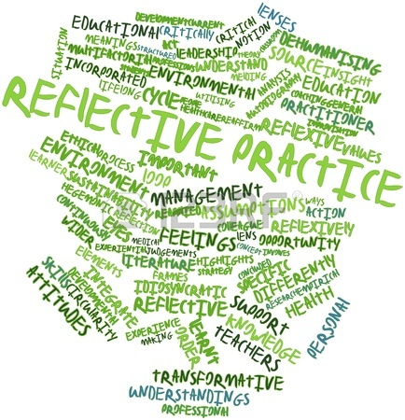
Additional Program Content
  Discovery process
  Coaching versus mentoring
  Joy of being a mentor or mentee
  Small group exercises
Notes:
Additional topics covered during Day 2 of our Mentorship program included topics such as the discovery process, coaching vs mentoring (where as Coaching= and Mentoring =), the joy of being either a mentor or mentee (group panel discussion of previous mentor and mentee pairs), small group exercises that fostered dialogue among the participants at each table, and formation of relationships with nursing colleagues outside their organization. These workshop discussions resulted in individual nurses sharing information as a spokesperson for small groups and allowed the participants to experience the perspective of other nurse leaders.
Mentoring---at its heart---is a process in which a wise and trusted counselor or teacher, known as a mentor, provides age advice to a less experienced individual known as a mentee.
Coaching—in comparison– is focused on developing an employee’s skills and knowledge to improve performance.

Slide 51
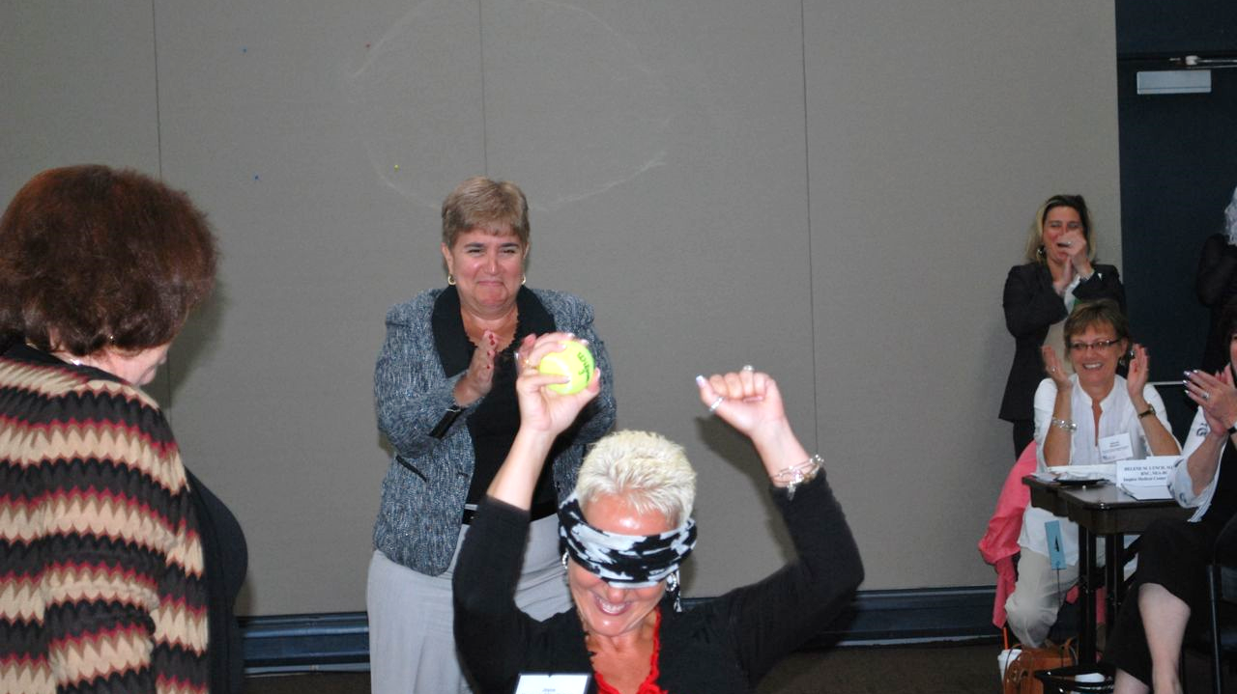
Additional Program Content
Trust
Exercise

Slide 52

Toolkit Incorporation
  Mentor-mentee roles and responsibilities
  Mentorship phases
  Partnership agreement
  Relationship assessments
  Supplemental resources
  Checklists

Slide 53

Lifelong Process
An interesting phenomenon occurred when experienced nurse leaders who were enrolled as mentors shared the realization that professional development is a lifelong process and they would equally benefit from continued mentorship as a mentee while also serving as a mentor.
Notes:
One of the great take aways from our educational program was identified by a seasoned nurse leader who noted the following….. The realization that….
A great message that points out what we all know…learning is a lifelong process.

Slide 54
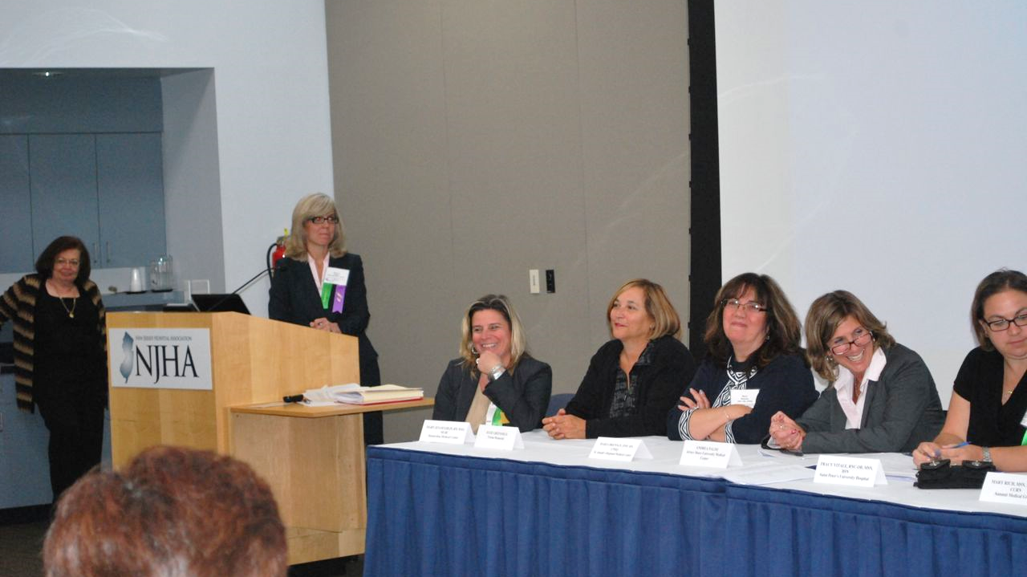
Panel of Mentors and Mentees
Notes:
Here is a photo of our panel of previous mentors and mentees. During the 2nd day, we incorporated this open forum that allowed a Q&A for the audience and sharing of experiences from both sides of the relationship. It really put the day and the process in perspective for those in attendance.

Slide 55
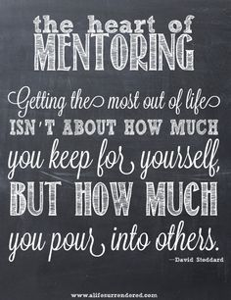
Program Completion
  Identification of Potential Matches
  Formal Pairing
  Notification of Mentors and Mentees
  Role of the Mentorship Committee
Notes:
So how do you end such a dynamic two day event?
Well, upon conclusion, participants were asked to list on an index card the names of 3 potential mentors or mentees they identified during the day for preferred matching/pairing.
The mentorship committee members took those suggestions along with the applications and had another “wedding planning event” where we formally paired the teams.
This was followed by formal letters and phone calls notifying the mentee of their pairing. Members of the Mentorship Committee became liaisons for the pairs over the course of the year long commitment. Each mentorship committee member was assigned 1-2 dyads and kept in contact with them every few months to ensure compliance with meetings, use of the toolkit, and to provide any needed support.

Slide 56

Qualitative Research Study
Replication Study February 2016
Include Cohort III & Cohort IV participants
  14 mentees
  14 mentors
  Data analysis being published

Slide 57
References
Academy of Medical-Surgical Nurses. AMSN mentoring program: Mentee guide. (2012). Retrieved from http://www.amsn.org/sites/default/files/documents/professional-development/mentoring/AMSN-Mentoring-Mentee-Guide.pdf
Academy of Medical Surgical Nurses. AMSN mentoring program: Mentor guide. (2012). Retrieved from http://www.amsn.org/sites/default/files/documents/professional-development/mentoring/AMSN-Mentoring-Mentor-Guide.pdf
  American Organization of Nurse Executives. (2015). AONE nurse executive competencies. Retrieved from http://www.aone.org/resources/nec.pdf

Slide 58
References
Bowen, D. (1985). Were men meant to mentor women? Training and Development Journal, 39(2), 30-34.
Chung, C. & Kowalski, S. (2012). Job stress, mentoring, psychological empowerment and job satisfaction among nursing faculty. Journal of Nursing Education, 51(7), 381-388.
Institute of Medicine. (2011). The Future of Nursing: Leading Change, Advancing Health. Washington, DC: The National Academies Press.

Slide 59
References
Kowalski K & Casper C. (2007) The coaching process: An effective tool for professional development. Nursing Administration Quarterly, 31(2), 171-179.
Ontario Nurses Association (2013). The mentor toolkit. Retrieved from https://www.ona.org/documents/File/education/ONA_MentorToolKit_201303.pdf
Rich M, Kempin B, Loughlin MJ, Vitale T, Wurmser T, Thrall TH. (2015). Developing leadership talent: A statewide nurse leader mentorship program. Journal of Nursing Administration, 45(2), 63-66.

Slide 60
References
The Regents of the University of California. (2012). The University of California, San Francisco Faculty Mentoring Toolkit. Retrieved from http://academicaffairs.ucsf.edu/ccfl/media/UCSF_Faculty_Mentoring_Program_Toolkit.pdf
Yoder, L. (1990). Mentoring: A concept analysis. Nursing Administration Quarterly, 15(1), 9-19.

Slide 61
Questions?
Tracy Vitale, DNP, RNC-OB, C-EFM, NE-OB
trv22@sn.rutgers.edu

